Slide 1

Science of Learning – Page 1
Hey there, super learners! Did you know your brain is an absolute marvel? It's like a sponge, always ready and eager to soak up new things every single day. Whenever you discover or learn something fresh, your awesome brain gets busy and forms tiny connections, known as synapses. These tiny pals work in perfect harmony, ensuring you remember and grasp things well. It's just like when you're building a bridge between cool ideas. And here's a secret: the more bridges you create, the smarter and sharper you become. Isn't that fascinating?
What does your brain act like when it learns? ___________________________________________________________________
What are the tiny connections in your brain called? ___________________________________________________________________
What do these tiny connections help you do? ___________________________________________________________________
Ever wondered how the phrase "practice makes perfect" came about? That's because our brains get super skilled and efficient the more we repeat an action. Imagine the first time you tried riding a bike. Felt tricky, didn't it? However, with every attempt, it gradually feels more natural. That's all thanks to your brain strengthening its bridges, or synapses. And guess what? Practicing doesn't only make you ace at biking but virtually everything! So every time you're practicing, remember: you're training your brain to be the best it can be!
What happens when you practice something a lot? ___________________________________________________________________
Why does riding a bike become easier over time? ___________________________________________________________________
Does practice help only with biking? ___________________________________________________________________

Slide 2

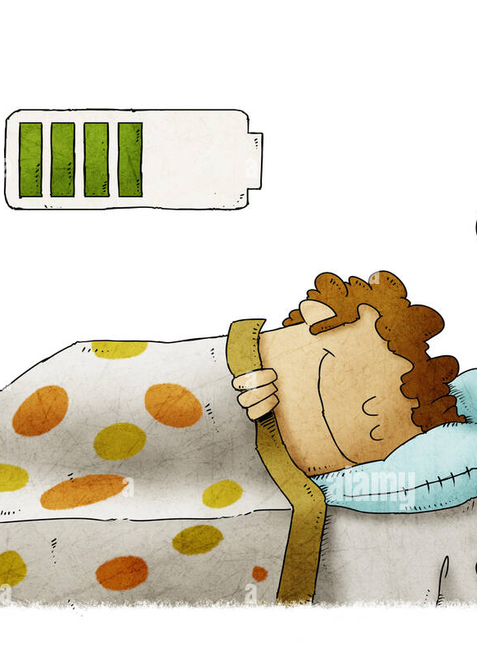
Science of Learning – Page 2
Alright, my brainy bunch! Here's a fun fact: ever wonder why breaks during study sessions are a thing? It's not just so you can relax your eyes or get some stretch time. Those breaks are golden moments that allow your brain to digest and process all you've learned. It's similar to how our tummies need a bit of downtime to handle the food we eat. Our brains, believe it or not, crave those little timeouts to make sense of all the new info. So, when you're on a break, imagine you're feeding your brain a delicious snack!
What do breaks help your brain do? __________________________________________________________________
Is the break just to rest your eyes? __________________________________________________________________
What are you giving your brain when you take a break? __________________________________________________________________
Let's dive into the magic of sleep! Did you know when you're deep in dreamland, your brain is anything but lazy? In fact, it's working hard! It's sorting, storing, and organizing all that you've learned during your awake hours. So if you've ever thought skipping sleep might be a good move, you might want to reconsider. Our brains need those precious Zzz's to cement and strengthen our learning. Think of a good night's sleep as a power-up session for your brain. Charge it up, and wake up refreshed and ready to learn!
What is your brain doing while you sleep? __________________________________________________________________
Does your brain need sleep to make learning strong? __________________________________________________________________
What does sleep give your brain? __________________________________________________________________

